Slide 1
Weather Impact Analysis on Formula 1 Driver Performance
Cat Weiss, Akin Akinlabi, Gia Nguyen
MIDS W200 Fall 2023
December 14, 2023
Notes:
Hi Everyone,
We have done an EDA to assess the impact of weather on Formula 1 Driver Performance. This was done by Gia, Akin, and me!

Slide 2

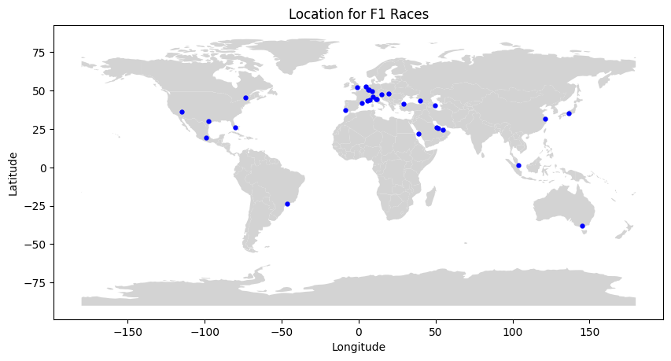
Introduction
[7]
Increase in Formula 1 popularity
New circuits
Driver reputation in varying weather patterns
Notes:
Formula 1 has exploded in popularity in the US in recent years, due to a hit documentary series on Netflix called Drive to Survive, and added races in the US including the Las Vegas Grand Prix this year.
While weather impacts many outdoor sports, there is a unique relationship between Formula 1 drivers and weather, as drivers and cars both have reputations for performing in certain weather conditions
In hot temperatures, drivers face the challenge of dehydration, with potential weight loss of up to 5% during the race, along with other factors like accelerated tire wear
and in cold temperatures and wet conditions, drivers face reduced visibility and declining brake performance
Because of the added races in places like Las Vegas and Jeddah, there are new weather conditions and challenges that drivers are facing with each season.
We were interested to explore an outside factor like weather on the effects of Formula 1 driver performance.

Slide 3
What is the impact of weather on Formula 1 in the 2018-2023 seasons?
Key Terms:
Formula 1
Teams
Drivers
Race
Notes:
This led us to our overall research question:
What is the impact of weather on Formula 1 in the 2018 to 2023 seasons? We have defined three subquestions that we will go into detail on in the following slides.
Before we dive into the analysis, we need to define some key terms:
Formula 1: Formula 1 is a motorsport that is the highest class of international racing for single-seater formula racing cars.
Teams: There are 10 Formula 1 teams per season, with a total of 14 teams in our dataset across 6 seasons
Drivers: There are 20 Formula 1 drivers per race, 2 per team. There are a total of 25 drivers in our dataset.
Race: In our dataset we included both in season races and sprint races, for a total of 125 races
Abnormal weather conditions: For our analysis, we defined abnormal weather conditions categorically as hot, cold, windy, and wet.
For our analysis, we made the following assumptions:
Machinery, meaning cars and their mechanical components are not equal between teams
We excluded reserve drivers and only kept drivers and teams that drove 38 races or more across 2018-2023. This is so we could reliably see patterns

Slide 4




Datasets
Race Dataset
Ergast API
Weather Dataset
Open-Meteo API
Master Dataset
Notes:
Gia
Race Dataset: merged 8 datasets from the Ergast API together, preprocessed the data in the format that we want and generated a new column called “F/DNF” which is a binary column where 0 means that the driver finished the race and 1 means that the driver Did Not Finish. We do not distinguish between reasons why a driver DNF.
Weather Dataset: Scrape from Open-Meteo API using the race ID, lat, long of the race location and start time in UTC. Retrieve the hourly weather variables for the date and location of each race and kept 4 hours of data per race.
Lastly, we merged them on race ID to create our master dataset

Slide 5
Exploratory Data Analysis
How have abnormal weather conditions influenced driver standings at the end of each race from 2018-2023?
Notes:
The first question we explored in our EDA is:
How have abnormal weather conditions influenced driver standings at the end of each race from 2018-2023

Slide 6
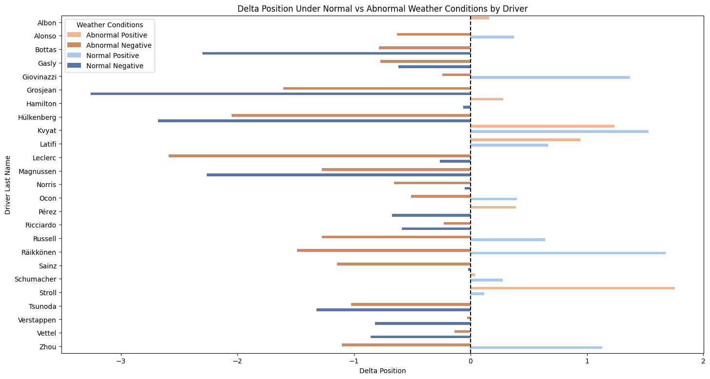
Position Change
Notes:
We calculated the average difference between the starting position and ending position for each driver in normal and abnormal weather conditions. Here you can see a bar chart that shows each driver’s position delta in each condition.
Some notable findings from this chart include:
18, or 72% of drivers had a net loss in abnormal weather conditions, compared with 13, or 52% of drivers having a net loss in normal weather conditions
7 or 28% of drivers had a positive delta in abnormal weather conditions, 10 or 40% drivers had a positive delta in normal weather conditions
With this data, we can see that generally drivers perform better in normal weather conditions

Slide 7
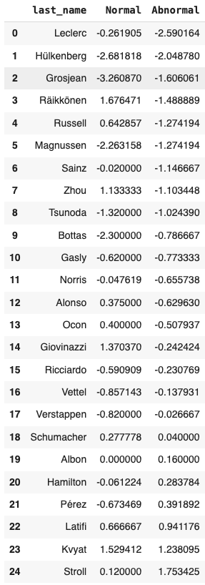
Position Change
Average position change over one
Abnormal Conditions: only 2 drivers
Normal Conditions: 4 drivers
Most consistent drivers have minimal change
Albon
Hamilton
sorted by Abnormal
Notes:
Here is the same data in table form showing each driver and their position delta in normal and abnormal weather conditions sorted by the abnormal variable. With this table, we can see some more specifics for each driver
Lance Stroll and Daniel Kyvat are the only two drivers that gained over a position on average in abnormal weather conditions
Kyvat kept it up with an average position change over 1 in normal conditions as well, showing versatility
In F1, the position you start is determined by the qualifying races just before the real race, this means the best drivers tend to start in the first positions, and have smaller deltas
consistent drivers like lewis hamilton and alex albon, for example, have very small deltas

Slide 8
Exploratory Data Analysis
2. Do specific drivers exhibit different DNF(Did Not Finish) rates under varying weather conditions?
Notes:
Akin
DNF – Define

Slide 9
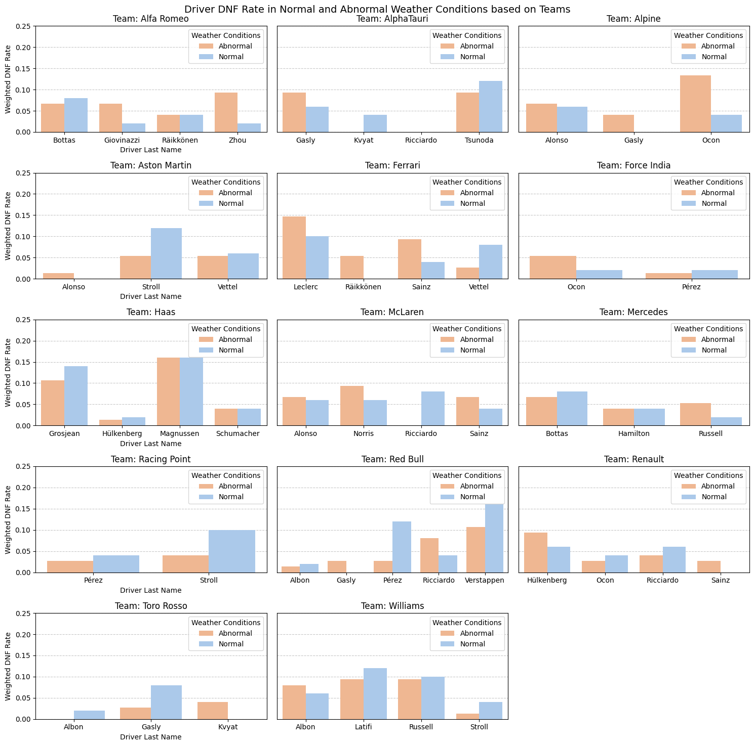
DNF Rate
The majority of drivers displayed higher DNF rates in abnormal weather conditions compared to normal conditions
Leclerc, Magnussen, Grosjean, and Verstappen are notable for their high DNF rates across both abnormal and normal weather conditions
Ocon, representing Alpine, is particularly challenged by abnormal weather conditions, standing out in this category

Slide 10
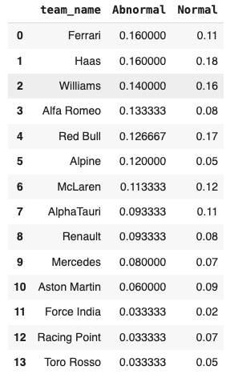
DNF Rate
50% of the teams exhibited DNF rates exceeding 10% in abnormal weather conditions
Ferrari and Haas are at the forefront with DNF rates of 16%
Alongside Haas, both Red Bull and Williams teams face challenges with DNFs in normal weather conditions
Mercedes and Aston Martin maintain DNF rates surprisingly below 10% in both abnormal and normal weather conditions

Slide 11
Exploratory Data Analysis
3. What patterns emerge in driver’s performance across different weather conditions?
Notes:
Gia
Driver’s Performance – driver’s ending position for each race
Weather conditions – hot, wet, normal (for more, see appendix)
Again, only comparing drivers from the same team

Slide 12
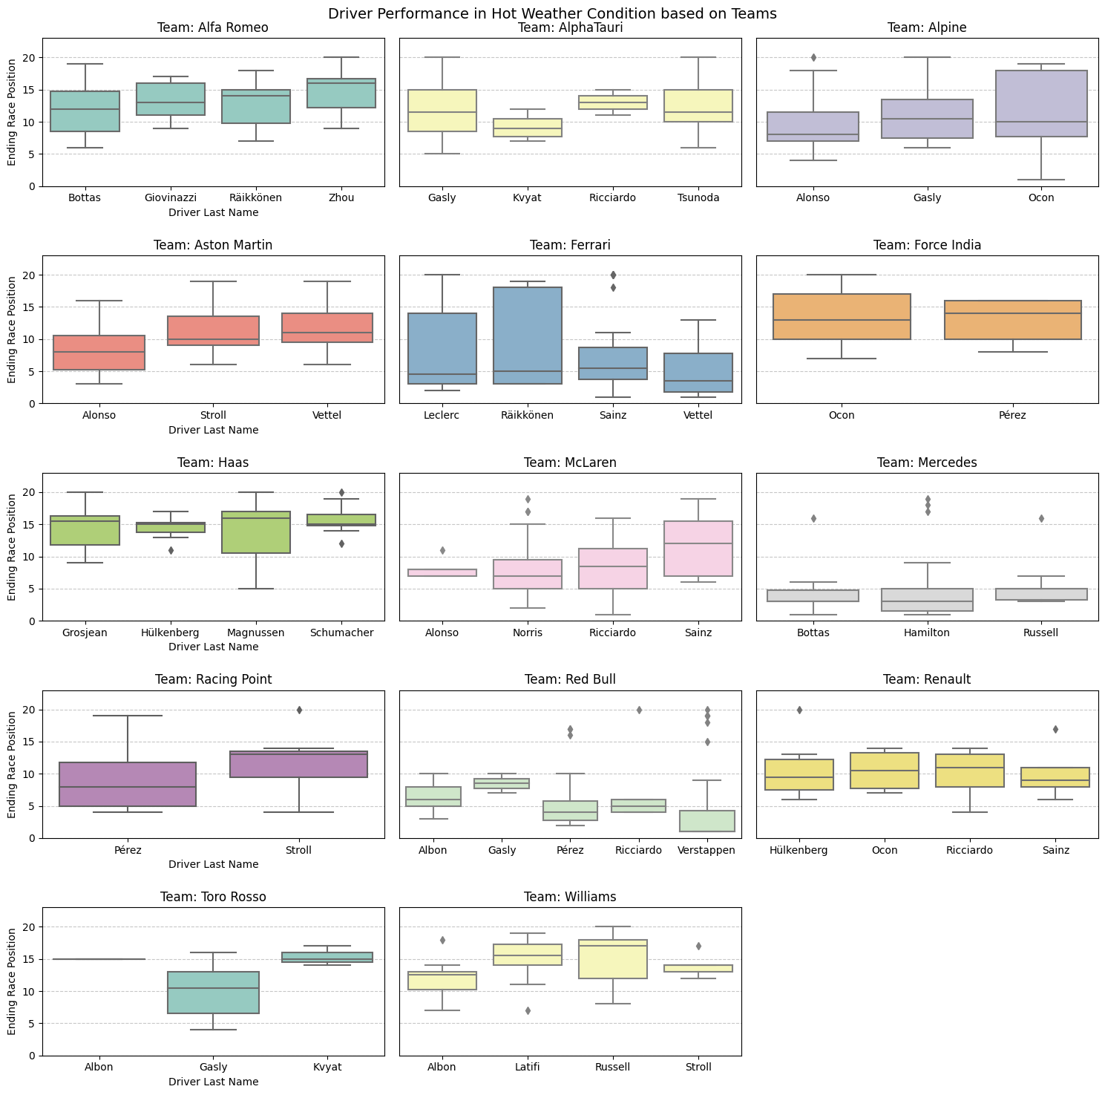
Hot Conditions
Key Takeaways:
Mercedes performs the best due to tighter interquartile (IQR) range with lower ending race positions
Ferrari have wider IQR range → more variability in their finishes
Notes:
75% of Leclerc’s finishes were in the 14th position or better – only 25% of the time that he finish worse than 15th position

Slide 13
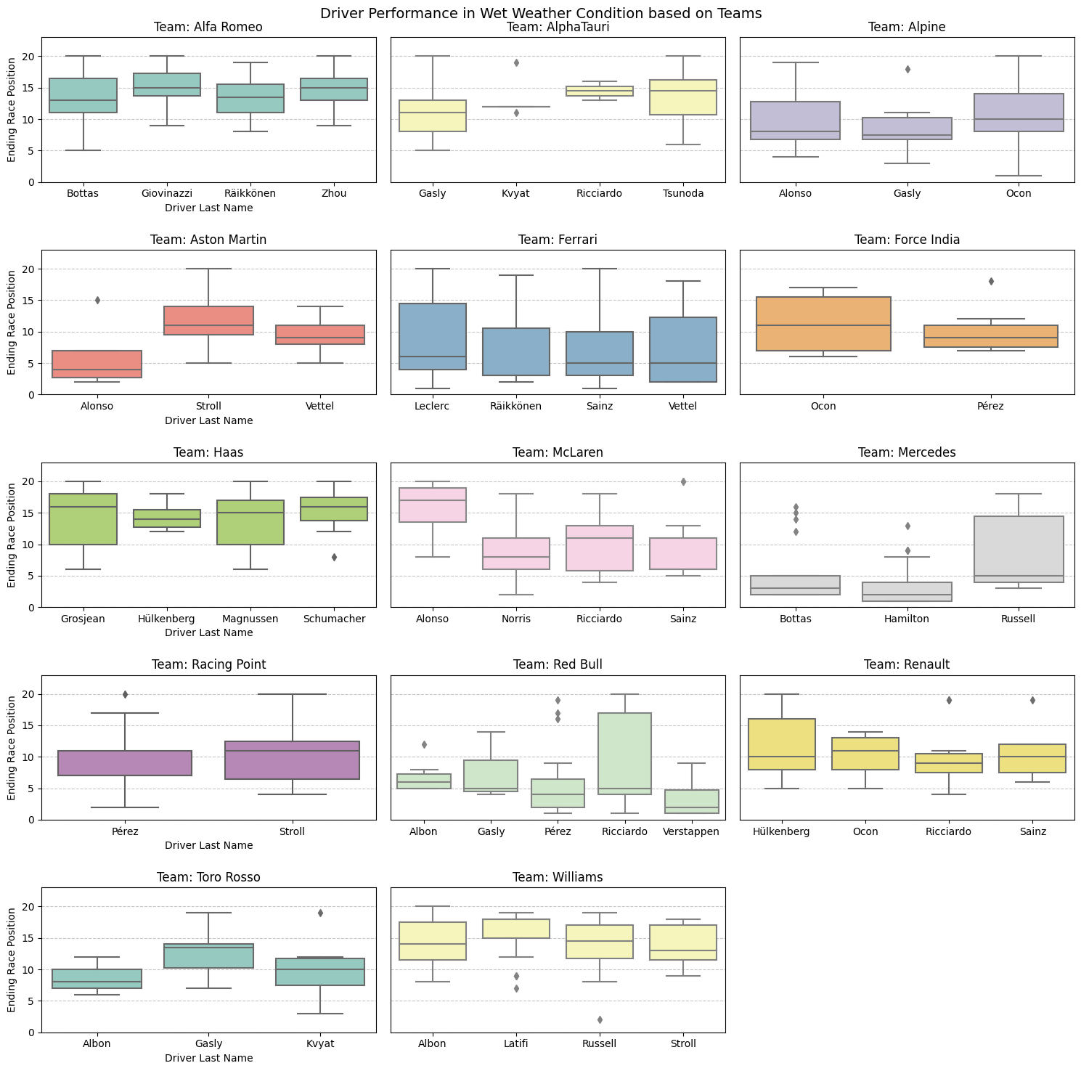
Wet Conditions
Key Takeaways:
Verstappen, Hamilton, Bottas performs exceptionally well under wet conditions with a few outliers
These 3 drivers are known for driving under wet conditions

Slide 14
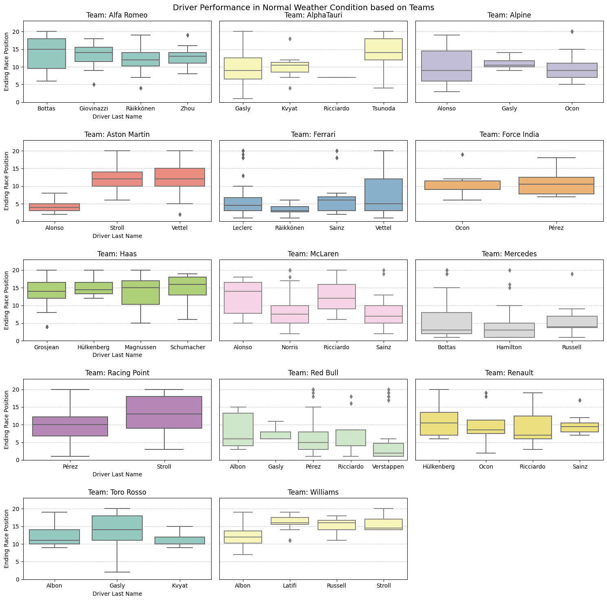
Normal Conditions
Key Takeaways:
More variability due to more data points
Lots of drivers did better under a specific abnormal weather conditions
Theory: under controlled weather, drivers tend to take more risks
Notes:
The dataframe for normal weather condition have more data points compared to each individual abnormal weather conditions dataframe
We would expect drivers to do better in a controlled environment but actually lots of them did better under a specific abnormal weather conditions

Slide 15
Conclusion
Abnormal weather conditions contribute to a high volume of races per season, posing frequent challenges for F1 drivers
These conditions lead to an increased DNF (Did Not Finish) rate of 15%, compared to a 14% rate in normal weather
Haas experiences the highest DNF rates in both weather categories
Kevin Magnussen has the highest individual DNF rates across all weather categories.
Romain Grosjean, his teammate, is also close behind in terms of high DNF rates
Max Verstappen has one of the highest DNF rates in both weather categories, yet he consistently ranks among the top performers
Mercedes and Aston Martin demonstrate remarkable reliability, maintaining lower DNF rates in both weather categories
Lewis Hamilton stands out as one of the few drivers with DNF rates below 5% in both weather categories and consistently ranks among the top performers

Slide 16
Q&A

Slide 17
Appendix

Slide 18
Abnormal Weather Criteria
We defined the criteria for abnormal weather conditions as follows:
Wet conditions: any race where precipitation is greater than 0 inches
Windy conditions: any race where the wind speed was greater than 25 miles per hour
Cold conditions: the bottom 10% of races by temperature, includes all races 62.4 degrees and below
Hot conditions: the top 20% of races by temperature, includes all races 80.3 degrees and above

Slide 19
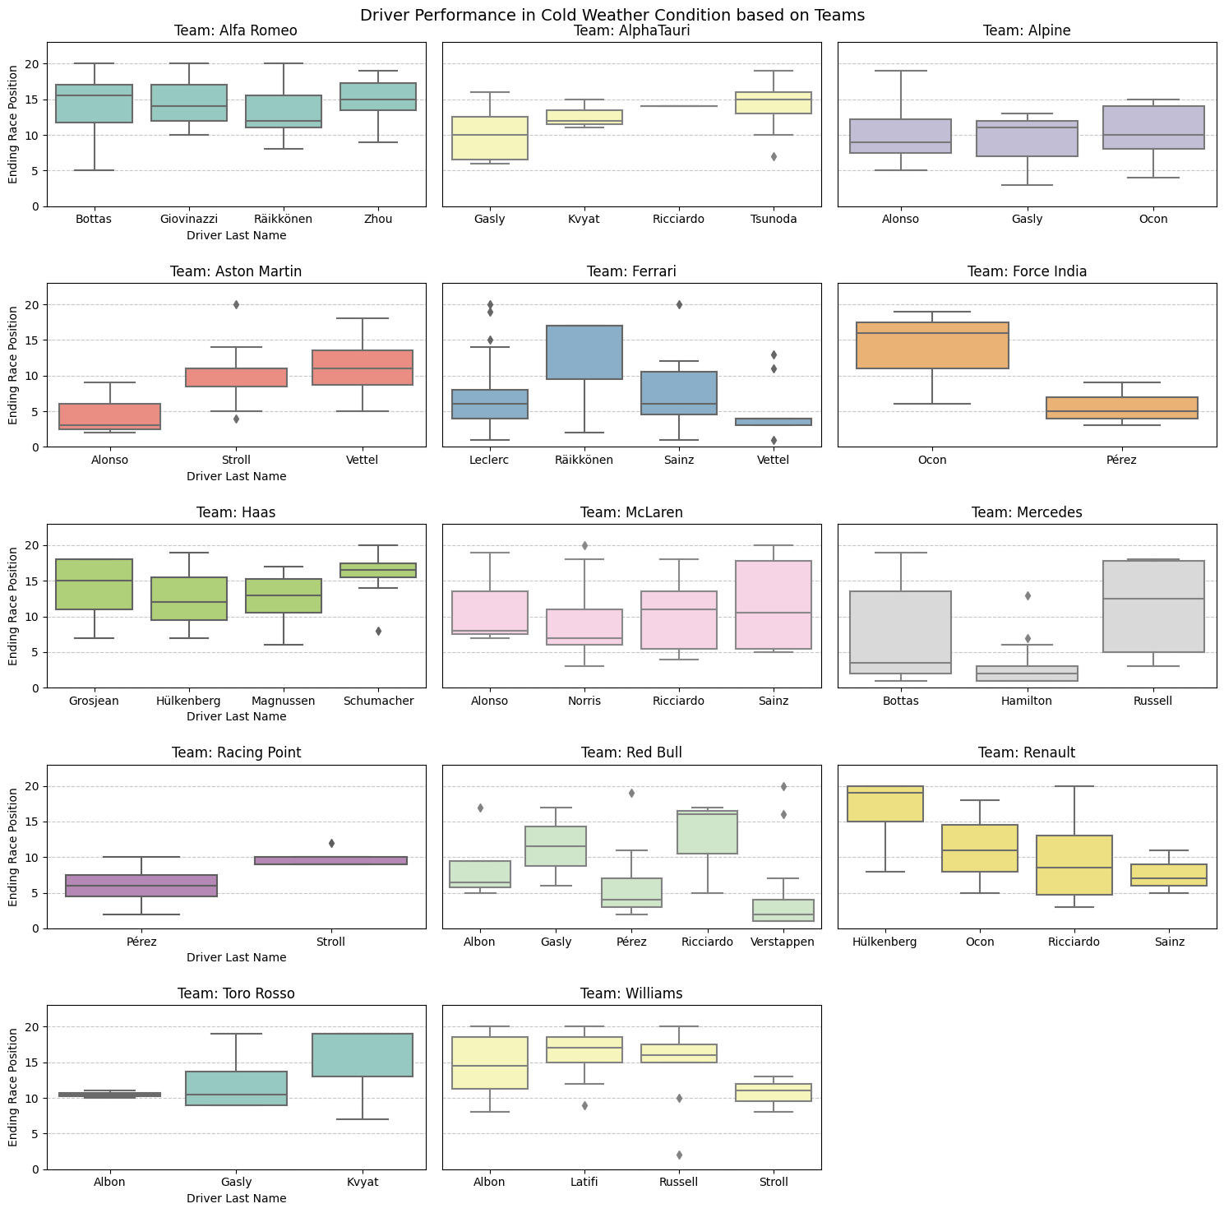
Cold Conditions
Key Takeaways:
Verstappen, Hamilton, Perez, Vettel and Alonso performs exceptionally well under cold conditions with a few outliers
Bottas, Russell and Ricciardo performs worse in this weather

Slide 20
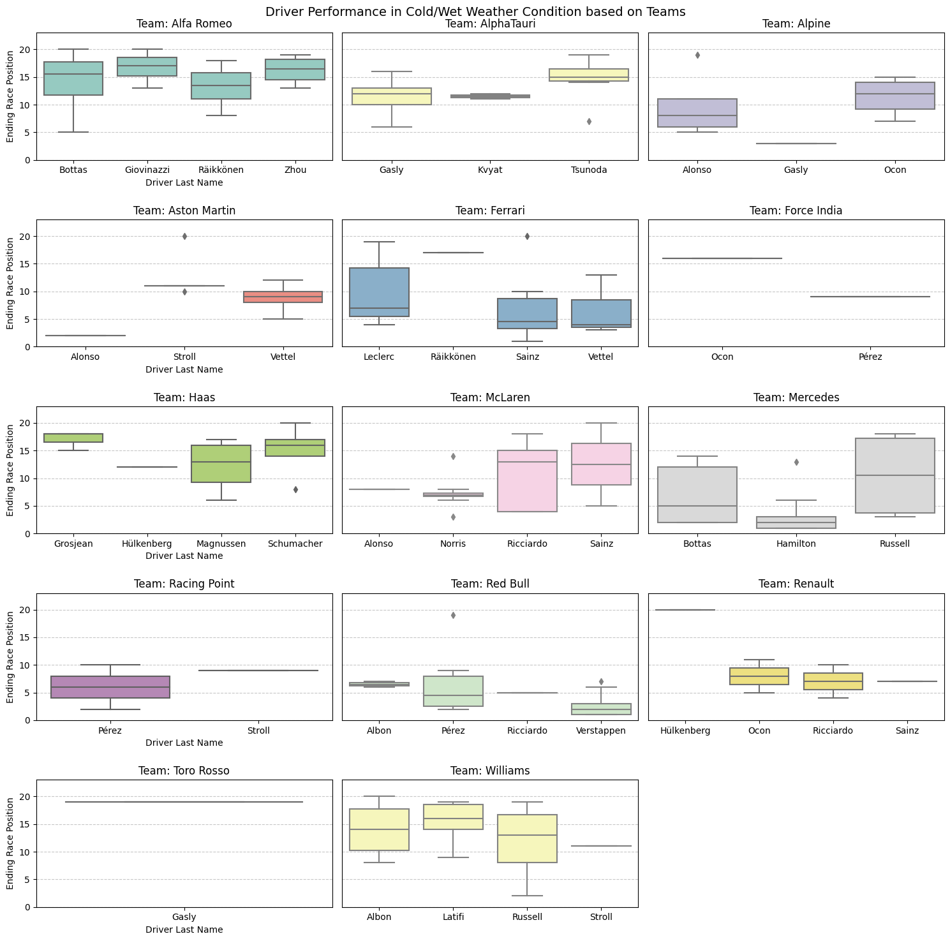
Cold/Wet Conditions
Key Takeaways:
169 entries for this combination of weather
Lots of drivers have only raced once
Hamilton and Verstappen stands out

Slide 21
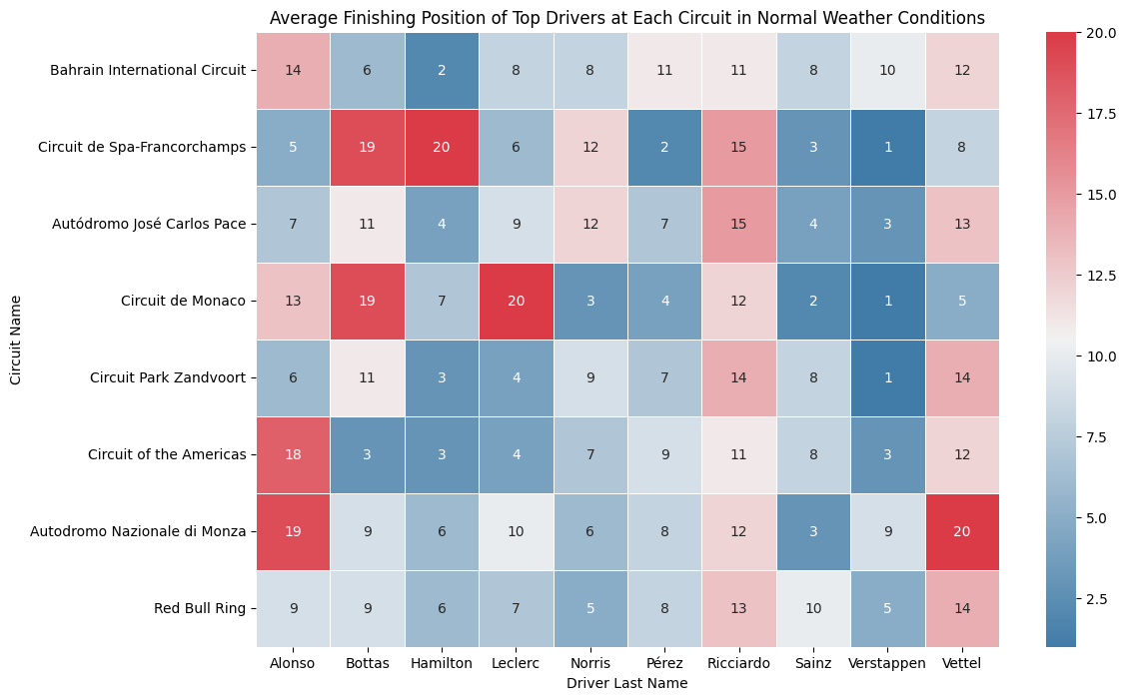
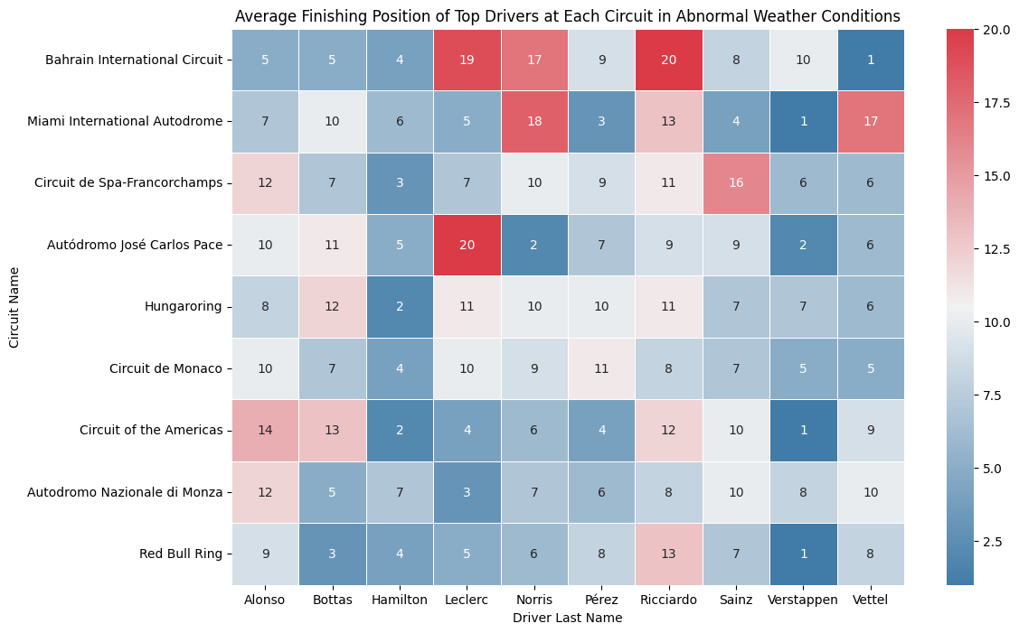
Heatmaps

Slide 22
References
Driscoll, Finnegan. (September 12, 2022). Formula 1 in the US: What’s behind its rise in popularity? [RTR Sports Marketing]
Brown, Maury. (March 29, 2023). Inside The Numbers That Show Formula 1’s Popularity And Financial Growth. [Forbes]
Hall, Andy. (March 3, 2023). Formula 1 Presents Unique Opportunities for Disney Advertisers. [ESPN]
News Team. (2022). How Weather Affects Formula 1. [William Hill]
Ergast Developer API. n.d. API Documentation. [Ergast]
Open-Meteo. N.d. Free Weather API. [Open-Meteo]
IMDB Drive to Survive [IMDB]

